Slide 1
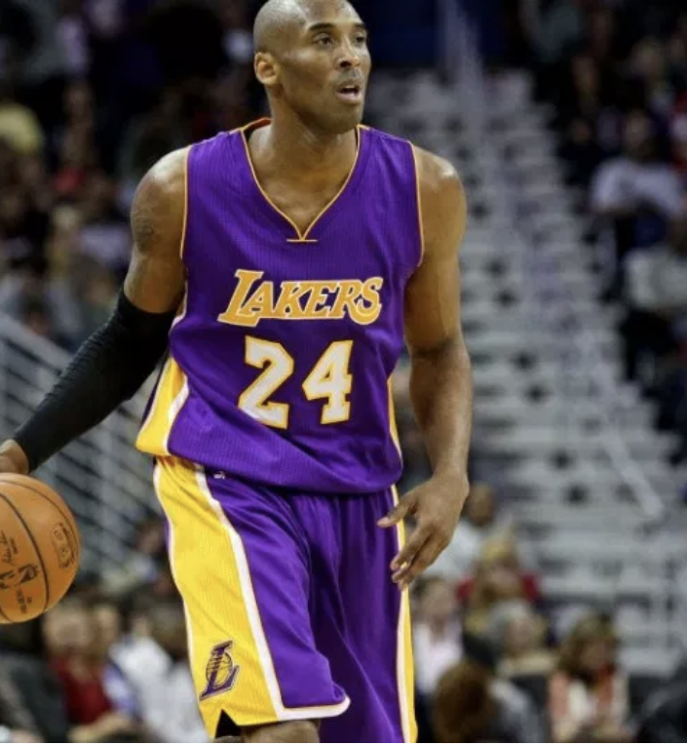
KOBE BRYANT SHOT SELECTION !!!

Slide 2
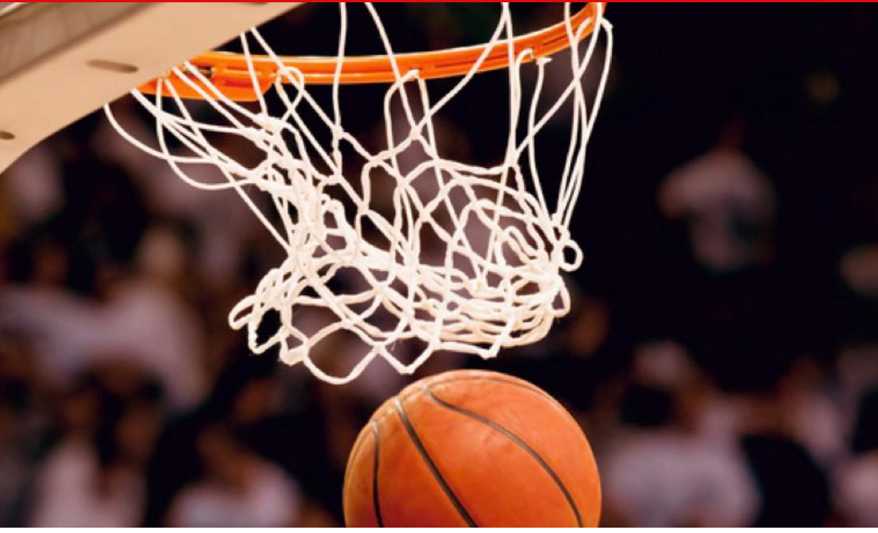
Problem statement:
As of today the shot outcome is simply a guessing game, our goal is to try a different approach to accurately predict the shot outcome using 20 years of data on Kobe’s swishes and misses and apply machine learning technique

Slide 3
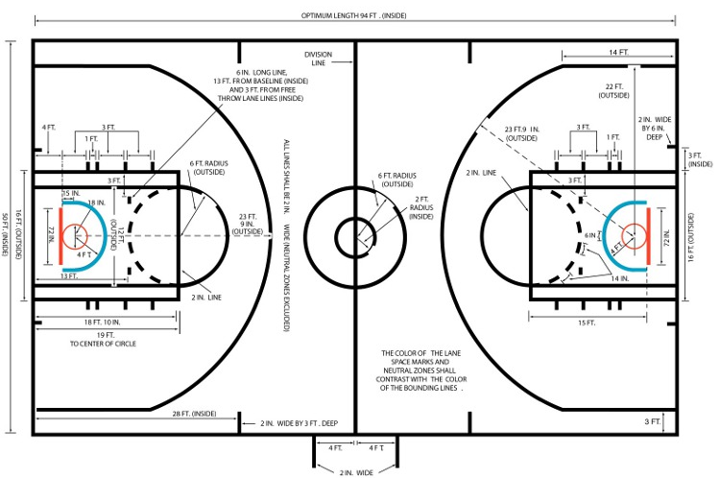
Data description & exploration
The dataset for this project originates from the Kaggle platform (https://www.kaggle.com/c/kobe-bryant-shot-selection/data). The Data consists of 20697 shots with 22 features which describe location and circumstance of every field goal attempted by Kobe
recId action_type combined_shot_type game_event_id game_id lat – court location identifier (latitude) loc_x - court location identifier (x/y axis) loc_y- court location identifier (x / y axis) lon - court location identifier (longitude) minutes_remaining – (in period) period playoffs season seconds_remaining attendance | avgnoisedb – avg noise in arena (decibels) shot_distance shot_made_flag (this is what you are predicting) shot_type shot_zone_area shot_zone_basic shot_zone_range team_id team_name game_date matchup opponent shot_id arena_temp (oF)

Slide 4
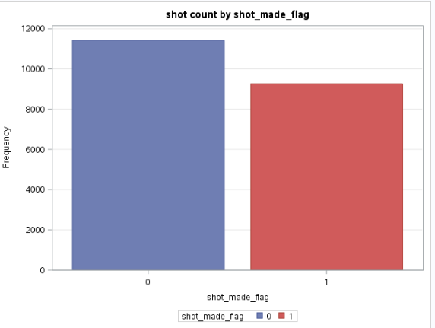
Out of 20697 shot the difference between made and missed shot are pretty significant

Slide 5
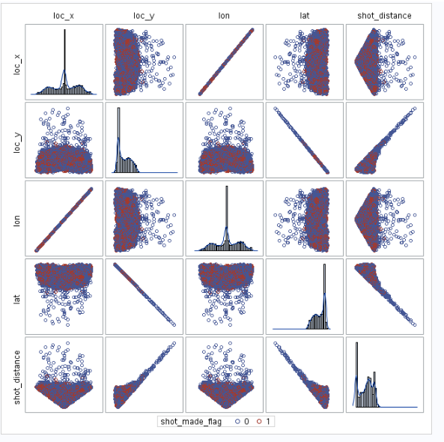
High correlation between lat and loc_y, lon and loc_x

Slide 6
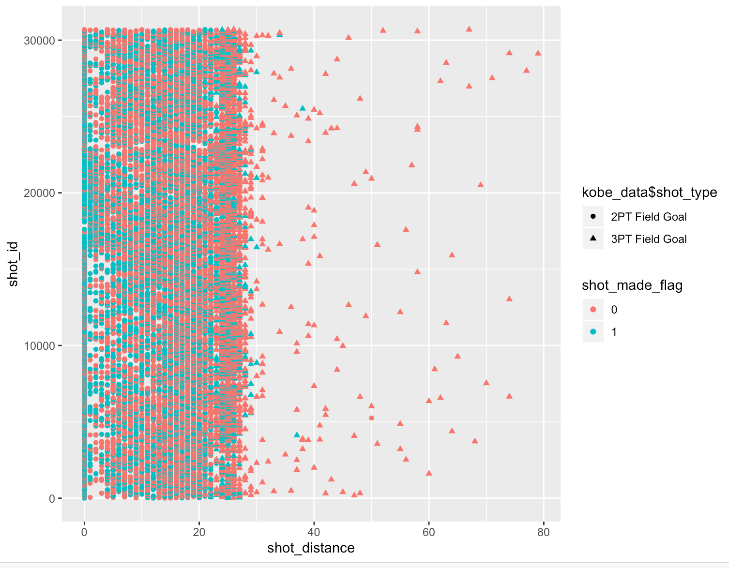
Most shots made when shot distance is below 25

Slide 7
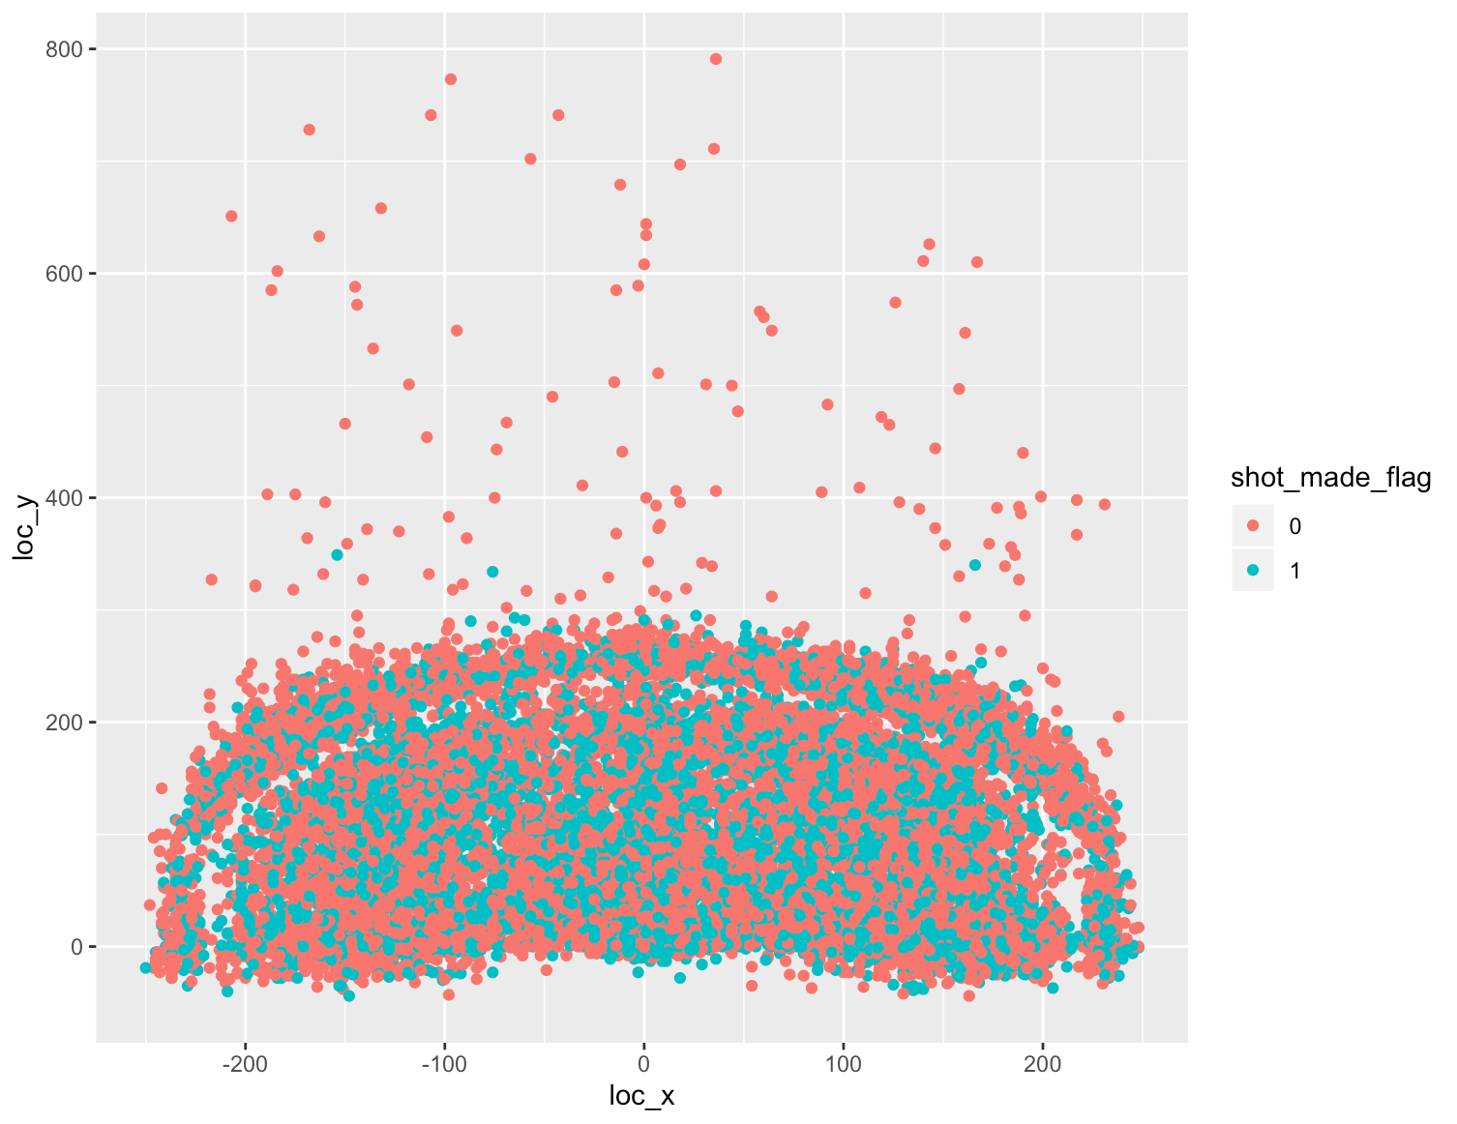
Court x-y coordinates has influence on success of shot

Slide 8
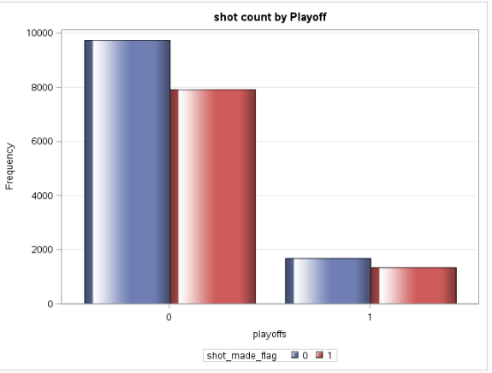
High variation of shot count based on playoff category

Slide 9
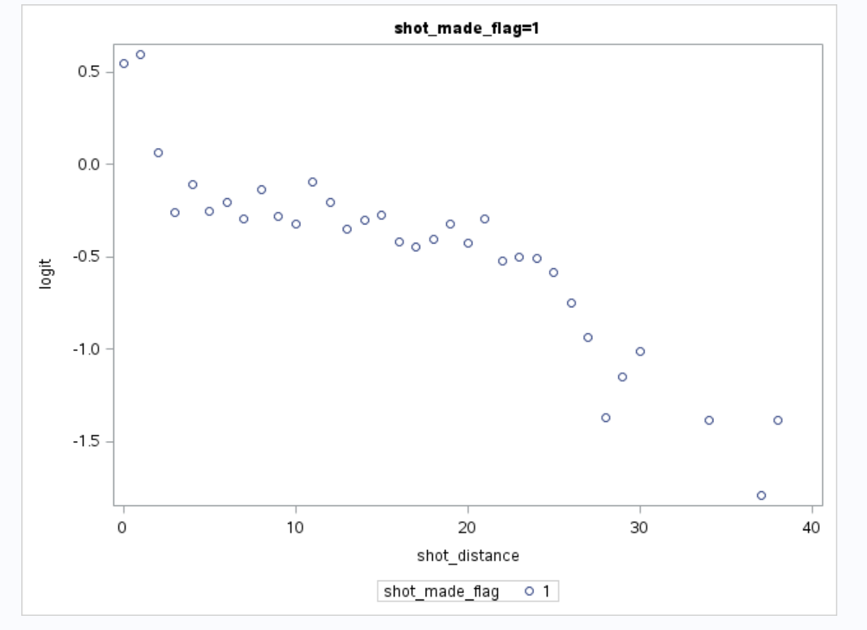
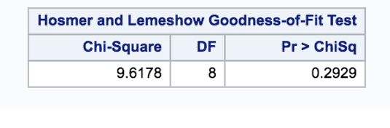
Assumption
Binary response variable: shot_made_flag is a binary variable where 0 represent missed shot and 1 represent made shot.
Model fitted correctly
Independent : each observation are independent from each other
Linearity of independent variable and log odds

Slide 10
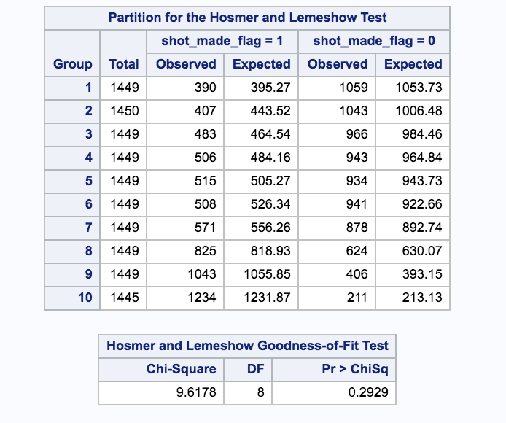
Goal : Build a Logistic model to predict the odd of successful shot
Assumptions checking for logistic regression
Included combined_shot_type, action_type, opponent and matchup into the SAS logictic model
proc logistic data=training; class shot_made_flag playoffs(ref='0') combined_shot_type shot_zone_range(ref='Less Than 8 ft.') action_type opponent matchup / param=reference; model shot_made_flag(event='1') = playoffs action_type shot_zone_range seconds_remaining avgnoisedb playoffs*shot_zone_range / selection=STEPWISE cl expb lackfit ctable outroc=troc stopres pprob=0.45 ; score data=testing fitstat outroc=vroc ; score data=testkobeshot out=results; run;

Slide 11
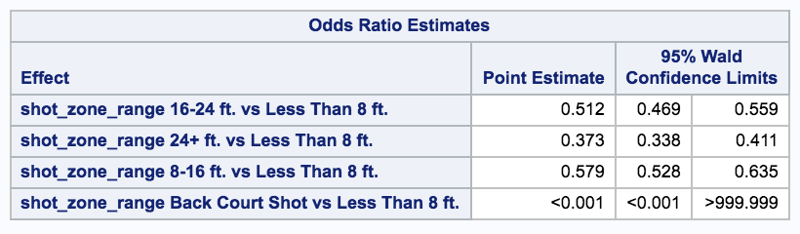
How distance to hoop affects Kobe’s shot
The odds of kobe making a successful shot if the distance from the hoop is in the range of 8-16ft is estimated to be 0.57 times that of hoop being with in 8ft range (p < 0.0001)

Slide 12
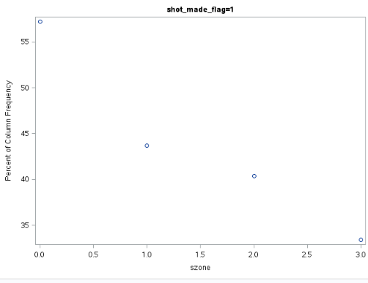
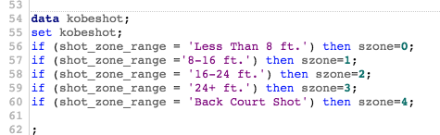
Kobe’s successful shots linearly goes down with distance from hoops

Slide 13
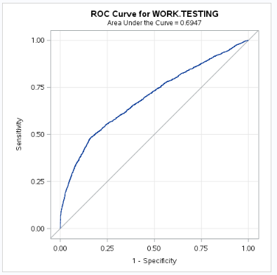

Error rate and other fit statistics for the model
32% of the samples were misclassified in
the test data

Slide 14
Conclusion: Kobe’s ability to get a successful shot is affected by his distance from the hoop.
Action type, average noise and seconds remaining are other parameter which will affect his ability to make a successful shot.

